Slide 1
Chapter 4 Methodologies
To be handled by

Slide 2
Chapter 4 –Methodologies
“Methodology Concepts” covers the concepts needed to design and compare methodologies.
“Methodology Design Principles” discusses 7 principles that can be used to guide the design of a methodology.
“XP under Glass” applies the principles to analyse an existing, agile methodology. It also discusses how to use the principles to adjust XP for slightly different situations.

Slide 3
An Ecosystem that Ships Software
“Methodology “ is everything we regularly do to get our software out
A methodology is the conventions that your group agrees to

Slide 4
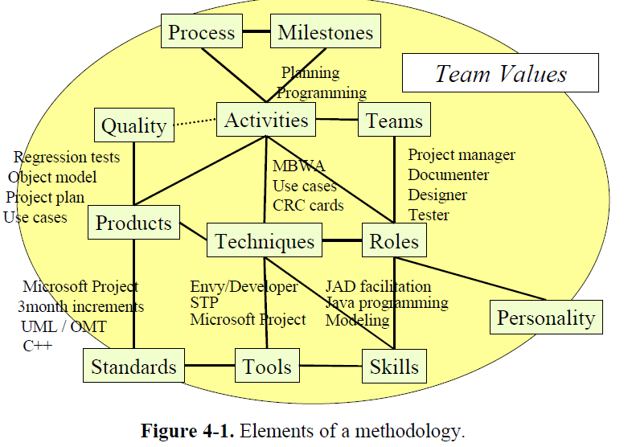
Methodology concepts

Slide 5
MBWA
The management by wandering around (MBWA), also management by walking around, refers to a style of business management which involves managers wandering around, in an unstructured manner, through the workplace(s), at random, to check with employees, equipment, or on the status of ongoing work. The emphasis is on the word wandering as an unplanned movement within a workplace, rather than a plan where employees expect a visit from managers at more systematic, pre-approved or scheduled times.

Slide 6
JAD
Joint application design (JAD) is a process used in the life cycle area of the dynamic systems development method (DSDM) to collect business requirements while developing new information systems for a company

Slide 7
CLASS RESPONSIBILITY COLLABORATOR (CRC)
SPANNING TREE PROTOCOL (STP)

Slide 8
Elements of methodology
Roles : who you employ, what you employ for them, what skills they are supposed to have
A project manager should be good with people
A program designer should have good abstraction capabilities
A Mentor should be good at explaining things

Slide 9
Skills : Training and talent is essential for employees
User Interface designers learn how to conduct usability examinations and do paper-based prototyping
Managers learn interviewing, motivating, hiring and critical path management skills
Skills can acquired through training and practice

Slide 10
Teams :
There may be one team for a small project
On a Large Project, there are likely to be multiple, overlapping teams aiming at
specific technologies or
system’s architecture or
steering the project

Slide 11
Techniques:
Specific procedures people use to accomplish task
Individual (single person) tasks are :
1. Writing a use case
2. Designing a class or test case
Group tasks are (done by a group of people)
1. Group planning sessions
2. Project retrospectives

Slide 12
Activities
How the people spend their days
Planning, programming, testing and meeting are sample activities

Slide 13
Process
How activities fit together over time and with pre and post conditions?

Slide 14
Work products
What someone constructs.
A work product may be disposable like user manual or source code
Milestones
Events marking progress or completion
Eg. A code is delivered, Meeting was held

Slide 15
Standards
Coding standards must be in practice
Eg. We will be using fully portable Java.
We will use Microsoft Project
Quality
All checked in code must pass unit tests at 100
Percent at all times
Team Values
An aggressive team working on quick-to-market value will work very differently than a group that values families and goes home at a regular time every night

Slide 16
Types of Methodologies
1. Normative
2. Rational
3. Participative
4. Heuristic

Slide 17
1. Normative
Based on solutions or sequences of steps known to work for the discipline
Electrical and other building codes in house wiring are examples
In software development, one would include state diagram verification

Slide 18
2. Rational
Based on a method and technique
They will be used for System analysis and engineering disciplines

Slide 19
3. Participative
Based on stake holders
Capture aspects of customer involvement

Slide 20
4. Heuristic
Based on lessons learned
Based on experience

Slide 21
Milestones
Three kinds of milestones are used on projects
Reviews
Publications
Declarations

Slide 22
Reviews
We care about the following questions during a review:
Who is reviewing?
What are they reviewing?
Who created that item?
What is the outcome of the review?

Slide 23
Publication
A publication occurs whenever a work product is distributed or posted for open viewing
Sending our meeting minutes, checking source code into a configuration-management system and deploying software to users’ workstations are examples of publication

Slide 24
Declaration
Declaration milestone is a verbal notice from one person to another or to multiple people, that a milestone was reached.
It is simply an announcement or a promise

Slide 25
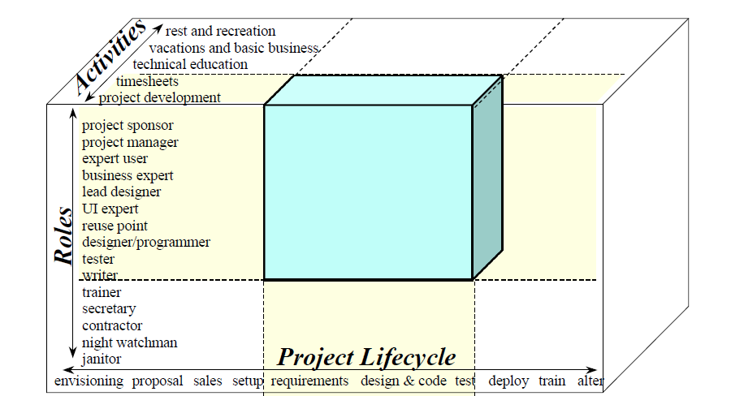
Scope of Methodology
The three dimensions of scope. A methodology selects a subset of all three.

Slide 26
Three dimensions of scope
Scope of methodology can be characterized along three axes :
Life cycle coverage
Role coverage
Activity coverage

Slide 27
Life cycle coverage
Life cycle coverage indicates when in the lifecycle of the project the methodology comes into play and when it ends
Role Coverage refers to which roles fall into the domain of discussion
Activity Coverage defines which activities of those roles fall into the domain of discussion

Slide 28
CONCEPTUAL TERMS
To Design a Methodology we have to analyse the following :
Methodology size : Number of control elements in the methodology.
Each deliverable, quality measure, activity and technique description are the control elements

Slide 29
2. Ceremony
Amount of precision and the tightness of tolerance in the methodology. Greater ceremony corresponds to tighter controls.
One team may write use cases on napkins and review them over lunch. Another team may prefer to fill in a three page template and hold half-day reviews. Both groups write and review use cases, the former using low ceremony and latter using high ceremony

Slide 30
3. Methodology weight=size X ceremony
4. Problem size : Number of elements in the problem and their inherent cross-complexity.
ex,. Launching a space shuttle is a bigger problem than printing a company’s invoice
Difficulty in deciding problem size is that there will be controversy over how many people are needed to deliver the product.

Slide 31
5 Project Size
Number of people whose efforts need to be coordinated: staff size
Depending on situation, we may coordinate only programmers or entire department with many roles

Slide 32
6. System Criticality
The damage from undetected defects.
Criticality can be classified based on loss of irreplaceable money or loss of life, loss of comfort.
7. Precision
Pi value=3.1 or to four decimal places,3.1416
Source code contains more precision than a class diagram; assembler code contains more than its high level source code

Slide 33
8. Accuracy
The final object model needs to be more accurate than the initial one.
The final GUI presentation is more accurate than the low-fidelity prototype.
9. Relevance
User Interface prototypes do not discuss the domain model
Infrastructure design is not relevant to collecting user functional requirements.

Slide 34
10. Tolerance
How much variation is permitted.
The team standards may require revision dates to be put into the program code-or not.
11. Visibility.
How easily an outsider can tell if the methodology is being followed.
Ex. ISO 9001 focus on visibility issues

Slide 35
12. Scale
How many items are rolled together to be presented as a single item.
The UML “package” allows for scaled views of use cases, classes or hardware boxes.
The printer or monitor’s dot density limits the amount of detail that can be put onto one screen or page. Even if it can be put up in one page, some people would not want to see all that detail. They want to see a rolled-up or high level version.

Slide 36
13. Stability
Wildly fluctuating-when a team is just getting started
Varying-when some development activity is in mid-stride
Relatively stable-as just before a requirements/design/code review or product shipment

Slide 37
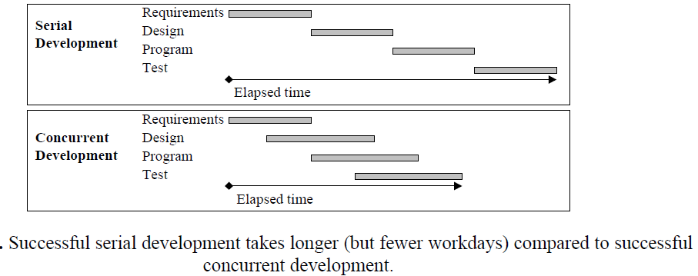
Serial development & concurrent development

Slide 38
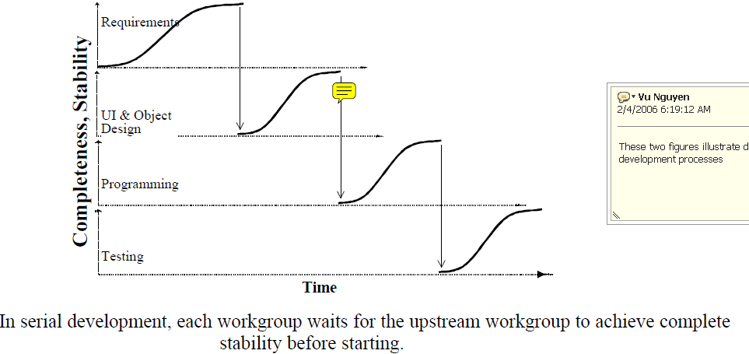

Slide 39
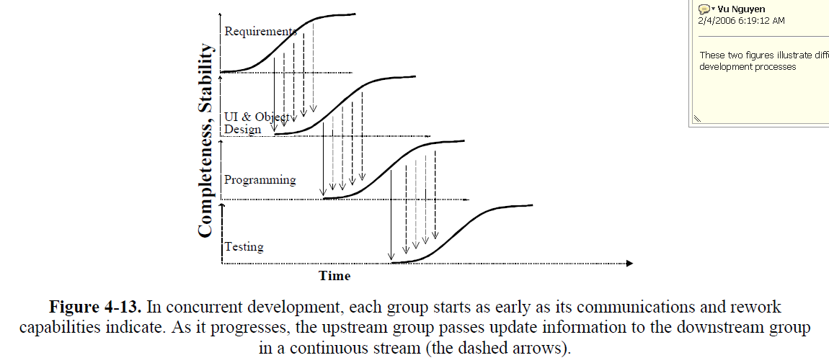

Slide 40
Serial development
The simplest approach is to say, "Don't start
designing until the requirements are Stable (with a capital 'S'); don't start programming until the design is Stable,” and so on. This is serial development. Its two advantages make it attractive to many people.

Slide 41
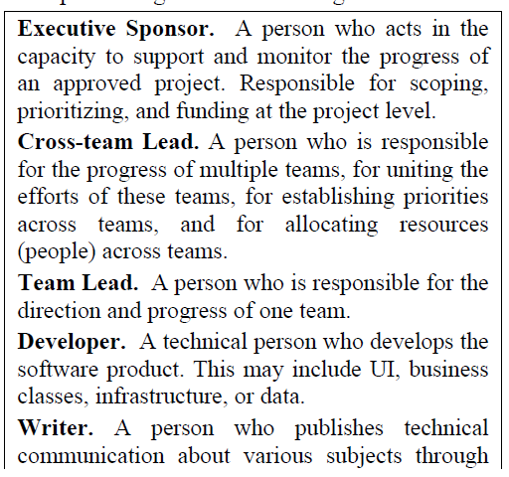
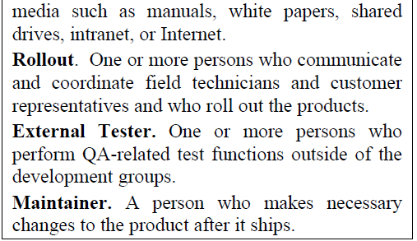

Slide 43
SEVEN PRINCIPLES WHICH ARE USEFUL IN DESIGNING AND EVALUATING METHODOLOGIES

Slide 44
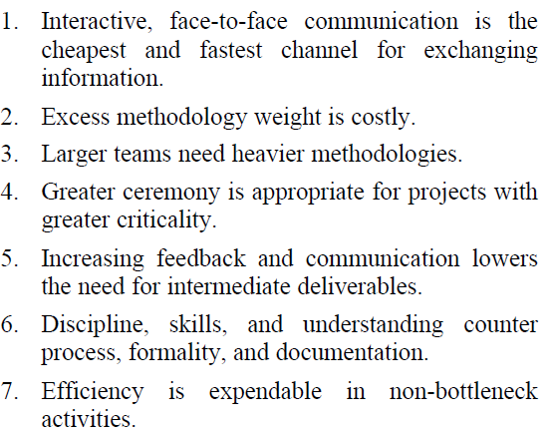
Seven principles useful in designing and evaluating methodologies

Slide 45
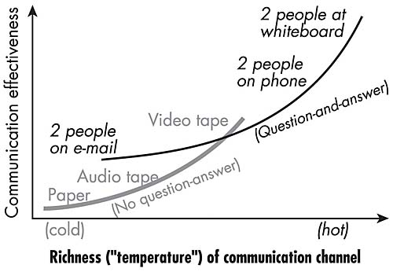
Principle 1 : Interactive, face-to-face communication is the cheapest and fastest channel for exchanging information
Discussed in last chapter (warm & cool communication)
Reduce cost of detecting and transferring information

Slide 46
Principle 2 : Excess methodology weight is costly
Imagine six people working in a room with osmotic communication, drawing on the printing whiteboard.
{The reduction in cost when people discover; information in background sounds(osmotic communication}
Their communication is efficient
Most of their time is spent developing software and usage manual

Slide 47
Principle 2 Contd…
Now ask them to maintain additional work products like GANTT charts, requirements documents, design documents and test plans
They are not truly needed by the team for development.
They take time away from development
Now productivity decreases

Slide 48
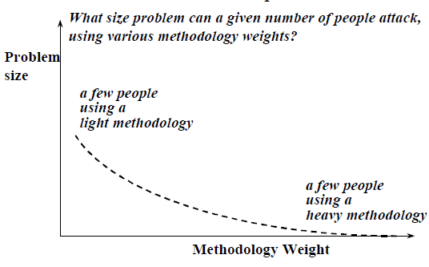
When you add more work, for the team, it pulls them away from their development work
In other words, a small team can succeed with a larger problem by using a lighter methodology

Slide 49
Designers are unable to get the necessary quiet time to do their work because of the burden of paperwork and the high rate of distractions
Adding a “small” amount of burden to a project adds a large cost

Slide 50
Principle 3 : Larger teams need heavier methodologies
If team size is larger, it is difficult to find out what are they doing
As team size increases, coordination and communication is very important
Figure shows the effect of adding methodology to a large team
With very light methodologies, they work without coordination

Slide 51
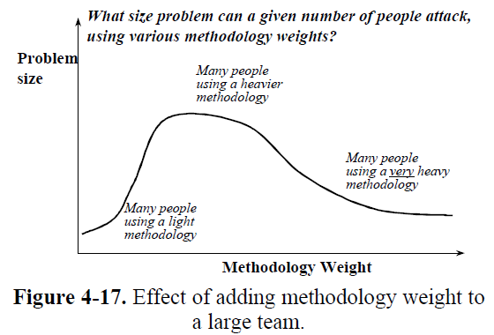

Slide 52
As they start to coordinate their work, they become more effective.

Slide 53
Principle 4 : Greater ceremony is appropriate for projects with greater criticality
It addresses the amount of ceremony that should be used on a project
More ceremony means tighter controls and less tolerance
Refer to previous ceremony examples.

Slide 54
Principle 5 : Increasing feedback and communication reduces the need for intermediate deliverables
An intermediate deliverable may be detailed project plan, analysis & design document, test plan, risk list and so on
Deliver the working piece of the system quickly enough that the sponsor can tell whether the team understood the requirements properly

Slide 55
Reduce the team size, putting everyone close enough together that they can simply tell each other what they are doing instead of writing internal documents to each other

Slide 56
Principle 6 : Discipline, skills and understanding counter process, formality and documentation
Process is not discipline
Discipline involves a person choosing to work in a way that requires consistency
Process involves a person following instructions
Of the two, discipline is more powerful

Slide 57
A person who is choosing to act with consistency and care will have a far better effect on the project than a person who is just following instructions
Don’t confuse formality with skill
Eg. Routine form filling work in a system
compared with OO design

Slide 58
Principle 7 : Efficiency is expendable in nonbottleneck actvities
This principle, provides guidance in applying concurrent development
People on a bottleneck activity need to work efficiently as possible and cannot afford to do much rework.
Principle 7 has three consequences
Expendable (meaning): destroyed bcos it is not significant

Slide 59
Consequence 1 : Do whatever you can to speed up the work at the bottleneck activity
Every project has a bottleneck activity
To handle this :
Get better people doing that work
Get more people to do that work
Get better tools for the people doing that work
Get the work that feeds that activity to a more complete and stable state before passing it along

Slide 60
Consequence 2: People at the non bottleneck activities can work inefficiently without affecting the overall speed of the project
This is not obvious
One way for People to work inefficiently is to take long smoking breaks, surfing web and spend time at water cooler

Slide 61
Nonbottleneck people can spend their extra capacity by starting earlier, getting results earlier, doing more rework, and doing it earlier and doing other work that helps the person a the bottleneck activity.

Slide 62
Consequence 3: Applying the principles of expendable efficiency yields different methodologies in different situations, even keeping the other principles in place

Slide 63
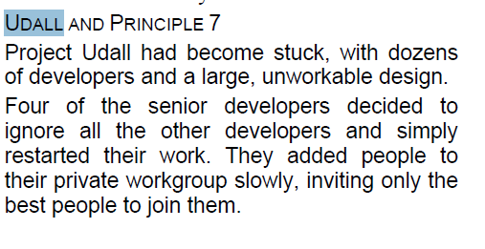
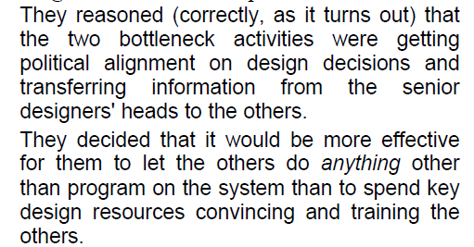

Slide 64
When I interviewed one of the team leads, I asked, "What about all those other people? What did they do?“
The team lead answered, "We let them do whatever they wanted to. Some did nothing, some did small projects to improve their technical skills. It didn't matter, because they wouldn't help the project more by doing anything else.“
The restarted project did succeed. In fact, it became a heralded success at that company.

Slide 65
Consequences of the Principles
Consequences of combining the principles
Consequence 1 : Adding people to a project is costly (Salaries)
Consequence 2 : Team size increases in large jumps (Read the case study )

Slide 66
SIX TO 24 PROGRAMMERS
At the start of one fixed-priced project, we estimated that we could deliver the project with six good Smalltalk programmers. That wasn't an option, though. At that time, we couldn't get our hands on six good Smalltalk programmers. To make matters worse, we were given ten novices to train and only two expert programmers to both train them and create code.
During our estimation process, we concluded we would need a staff of 24 programmers of mixed abilities. Over the course of the project, we eventually had four experts and 20 other programmers with mixed experience. We got our 24 programmers.
We reviewed our assessment at several times during the project, and at the end. Yes, six good Smalltalk programmers would have been sufficient. No, 12 programmers, even 16 programmers of the mixed experience levels we were seeing would not have been
sufficient. The correct jump was from six good programmers to 24 programmers of mixed ability

Slide 67
Consequence 3: Teams should be improved, not enlarged.
Here is a common problem: A manager has a ten person team that sits close together and achieves high communication rates with little energy.
The manager needs to increase the team's output.
He has two choices: add people or keep the team the same size and do something different within the team.

Slide 68
If he increases the team size from 10 to 15, the communications load, communications distances, training, meeting, and documentation needs go up.
Most of the money spent on this new group will get spent on communications overhead, without producing more output.

Slide 69
The second strategy, which seems less obvious, is to lock the team size at 10 people (the maximum that can be coordinated through casual coordination) and improve the people on the team.
To improve the individuals on the team, the manager can do any or all of the following:
Send them to courses to improve their skills.
Seat them closer together to reduce communications cost.
Improve their amicability and teamwork.
Replace some of the people on the team with more
talented (and more highly paid) people.
Repeating the strategy over time, the manager will
keep finding better and better people who work better
and better together.

Slide 70
Consequence 4: Different methodologies are needed for different projects
Select appropriate methodology depending on the nature of the project which includes :
* the number of people being coordinated
* the system criticality
* the project priorities
Consequence 5 : Lighter methodologies are better, until they run out of steam

Slide 71
A small team with a light methodology can sometimes solve the same problem as a larger team with a heavier methodology.
From a project cost point of view, as long as the problem can be solved with 10 people in a room, that will be more effective than adding more people.

Slide 72
Consequence 6 : Methodologies should be stretched to fit
Look for the lightest, most “face-to-face” centric methodology that will work for the project
Then stretch the methodology

Slide 73
XP UNDER GLASS
XP in a Nutshell
Use only 3-10 programmers. Arrange for one or several customers to be on site to provide ongoing expertise. Everyone works in one room or adjacent rooms, preferably with the workstations clustered, monitors facing outwards in a circle, half as many workstations as programmers.
Do development in three-week periods, or "iterations." Each iteration results in running, tested code of direct use to the customers. The compiled system is rolled out to its end users at the end of each release period, which may be every two to five iterations.

Slide 74
The unit of requirements gathering is the "user story," user-visible functionality that can be developed within one iteration. The customers write the stories for the iteration onto simple index cards. The customer(s) and programmers negotiate what will get done in the next iteration in the following way:
The programmers estimate the time to
complete each card.
The customers prioritize, alter, and de-scope as
needed so that the most valuable stories are
most likely to get done in the allotted time
period.

Slide 75
The programmers write the tasks for each story on flipcharts on the wall or a whiteboard, estimating the time they will need for each task.
Over time, the customers and programmers can reprioritize or de-scope the tasks or stories.
Development on a story starts with the
programmers discussing the story with the expert
customer.

Slide 76
Programmers work in pairs. They follow strict
coding standards that they set up at the beginning
of the project.
They create unit tests for everything they write and make sure that those tests run at 100% every time they check in their code to the mandatory versioning and configuration management system.
They develop in tiny increments of 15 minutes to a few hours long, integrating their code several times a day. At the end of each of these integrations, they ensure that the entire code base passes all unit tests.

Slide 77
While the programmers are working, the customers are doing three things:
They visit with the programmers to clarify ideas, they write system acceptance tests to be run during and at the end of the iteration, and they select stories to be built for the next iteration. They may be on the project full time or not, as they decide.
The team holds a stand-up meeting every day, in which they describe what they are working on, what is working well for them, and what they might need help with. The meeting is held standing up to keep it short. At the end of each iteration, they hold another meeting in which they review what they did well and what they want to work on next time. They post this list for all to see during the next iteration.

Slide 78
XP prizes four values: communication,
simplicity, testing, and courage.
The "courage“ value is intended as courage to go ahead and make improvements to the system at any time.
One person on the team is designated the
"coach" for the team. This person reviews with the team members their use of the key practices: use of pair programming and testing, pair rotation, keeping design simple, communicating, and so on.

Slide 79
An XP team makes great use of osmotic
communication, face-to-face communication, convection currents of information flow, and
information radiators on the wall.
Feedback is rapid. The customers get quick
feedback as to the implementation implications of their requirements requests during the planning session. They see running code within days and can adjust accordingly their views on what should really be programmed.

Slide 80
XP is a high-discipline methodology. It calls for
tight adherence to strict coding and design
standards, strong unit test suites that must pass at all times, good acceptance tests, constant working in pairs, vigilance in keeping the design simple, and aggressive refactoring.

Slide 81
There are some high-ceremony (low-tolerance)
standards. The policy standards include the use of
iterations.
* Design and programming are done in
tiny increments of hours or a few days.
* Planning and development cycles are two to four weeks, releases one to four months.
* The testing policy standard is that all unit tests run at 100% for all checked-in code. A policy standard states that the team is to be colocated, with a strong
recommendation toward the "caves and commons"
seating.

Slide 82
Why methodology at all?
Benefits of using methodology
1. Introducing new people to the process
"Hi, how do we work around here?" is a natural question for new team members to ask. It is helpful to have something available so they can learn their place in the organization.

Slide 83
2. Substituting people
Although people are not plug-replaceable, they often do need to be replaced
A colleague was being hired by a contracting
company he didn't know, to do some proposal
work in a field he didn't know, for a client he
didn't know.
The contract lead sat with him for two days
reviewing the company’s methodology: who
produced what, how the work products were
structured, what standards were needed, what
his priorities should be, who he would talk to.

Slide 84
3. Delineating responsibilities
A methodology indicates what is not part of a
person's job. Thus, XP states that decisions about a story's priority belong to the customer, not the programmer; design estimates are made by the programmers, not the customer.

Slide 85
4. Impressing the sponsors
5. Demonstrating visible progress
Related to impressing the sponsors, the purpose of the methodology may be to allow the contractors to show their sponsors what they have been doing.
XP team could show every single day to demonstrate visible progress to the sponsors.
6. Curriculum for education

Slide 86
After a methodology names techniques and
standards for people to use, courses can be found or
designed that teach skills around those techniques
and standards.
For example, the people can be sent, according to
their job responsibilities, to develop skills in writing
use cases, facilitating meetings, semantic modeling,
programming, and the use of various tools.

Slide 87
Evaluating a Methodology
In light of the above, how might you evaluate a methodology?
You would first ask why the methodology exists, and then what game you are playing. Based on those you might evaluate the methodology for:
* How rapidly you can substitute or train people
* How great an effect it has on the sales process
How much freedom it gives people (or how constraining it is)
How fast it allows people to respond to changing situations
How well it protects your organization from lawsuits or other damage
----------------------------End of Chapter 4------------------------------

